Slide 1
SCILAB LECTURE DISCRETE TIME SIGNALS
Ashok Ranade

Slide 2
Transformation of independent variable
Time Shift
Delay or advance
Time scaling
Compression or Expansion
Time inversion
Combined operations

Slide 3
Time Delay
x(t)
y(t) = x(t-1)
0
1
2
t
y(t)
0
1
2
t

Slide 4
Time Advance
x(t)
y(t) = x(t+1)
0
1
2
t
y(t)
0
1
2
t

Slide 5
Assignment
Write a Scilab program to do the following
Generate a half cycle of sine wave of period T
Chose the sampling frequency of 100 times the frequency of sine wave.
Total simulation time is from -3T to 3T.
The signal should be the above halfcycle starting from t = 0. All other samples are zero
Generate a output y such that y = x(t-td) or y = x(t+td) as specified.
Plot x and y

Slide 6
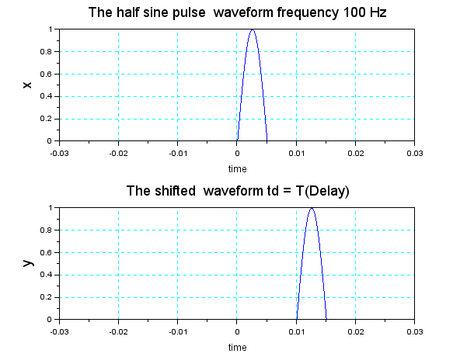
A possible output delayed signal

Slide 7
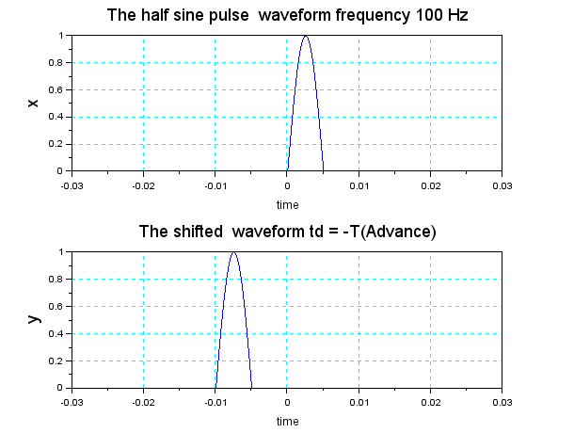
Plot of advanced signal

Slide 8
Program(File : Sine pulse shift)
clear; clf; f = 100;
T = 1/f; fs = 100*f; ts = 1/fs;
t = 0:ts:T/2; xp = sin(2*%pi*f*t);
Np = length(xp); td = -T;
t1 = -3*T:ts:3*T; N = length(t1);
t2 = -3*T : ts: td;
t2x= -3*T:ts:0;
N1x = length(t2x);
N2x = N-Np-N1x;

Slide 9
Program continued
N1 = length(t2);
N2 = N-Np-N1;
x = [zeros(1,N1x),xp,zeros(1,N2x)];
y = [zeros(1,N1),xp,zeros(1,N2)];
subplot(211);
plot(t1,x); xgrid(4); title("The half sine pulse waveform frequency 100 Hz ", "fontsize",4);
xlabel("time","fontsize",2);
ylabel("x","fontsize",4)
subplot(212);
plot(t1,y); xgrid(4); title("The shifted waveform td = -T(Advance) ", "fontsize",4);
xlabel("time","fontsize",2);
ylabel("y","fontsize",4)

Slide 10
Time delay(Discrete Time Signals)
x(n)
y(n) = x(n-1)
-3
-2
-1
0
1
2
3
y(n)
-3
-2
-1
0
1
2
3
4
n

Slide 11
Time Shifting (delay)
y(n) = x(n-n₀)
If n₀ > 0 the signal is shifted to the right
Provides a delay of n₀ samples
x(n) = { 1, 2, 3, 4, 3, 2, 1}
y(n) = x(n-2)
y(n) = { 1, 2, 3, 4, 3, 2, 1}

Slide 12
Time shifting(Advance)
y(n) = x(n-n₀)
If n₀ < 0 the signal is shifted to the left
Provides an advance of n₀ samples
x(n) = { 1, 2, 3, 4, 3, 2, 1}
y(n) = x(n+2)
y(n) = { 1, 2, 3, 4, 3, 2, 1}

Slide 13
Program assignment
Write a program to demonstrate the delay or advance of a digital signal. For this do the following
Define a digital pulse xp by generating a sequence of arbitrary N numbers. The pulse starts at n =0
Vary n from -3N to 3N
Generate x by putting appropriate sequences of zeros to the right and left of the pulse xp
Generate y = x(n-nd) or y = x(n+nd)

Slide 14
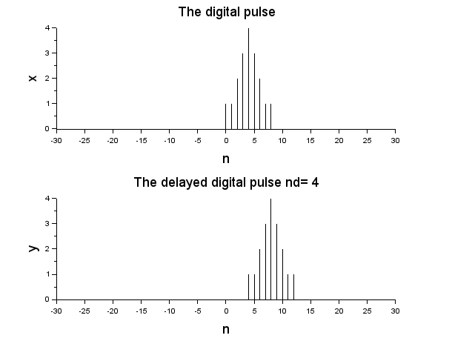
A possible output. (Delay)

Slide 15
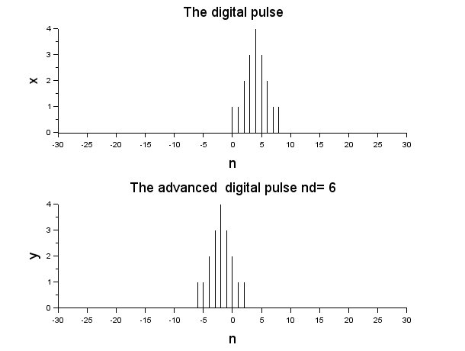
A possible output (Advance)

Slide 16
Program
clear; clf; clc;
xp = [1 1 2 3 4 3 2 1 1 0];
nd = 5;
N = length(xp);
n = -3*N:3*N;
x = [zeros(1,3*N),xp,zeros(1,(2*N+1))];
y = [zeros(1,3*N+nd),xp,zeros(1,(2*N+1)-nd)];

Slide 17
Program continued
subplot(211);
plot2d3(n,x);
xlabel("n","fontsize",4); ylabel("x","fontsize",4); title("The digital pulse","fontsize",4) subplot(212); plot2d3(n,y);
xlabel("n","fontsize",4); ylabel("y","fontsize",4); title("The advanced digital pulse nd= 6 ","fontsize",4)

Slide 18
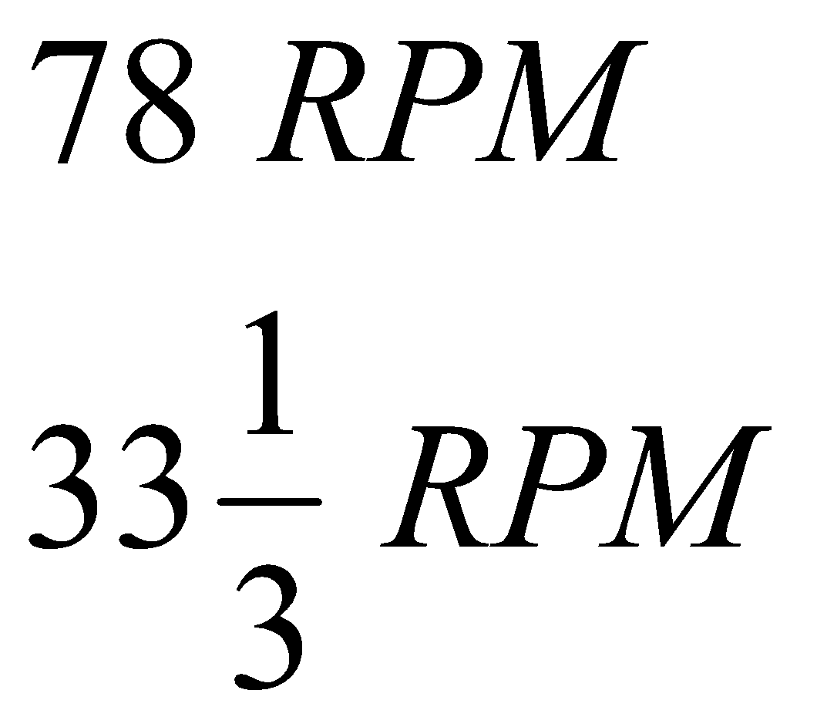
Time scaling
Background
Audio recording and playing
Old disc records
Two major speeds
Recording and playing speeds must be same

Slide 19

Result of unequal speeds
Recorded at lower speed
Played at higher speed
Shorter duration and higher frequencies

Slide 20

Result of unequal speeds
Recorded at higher speed
Played at lower speed
Longer duration and lower frequencies

Slide 21
Solution
Record at one speed
Play at same speed
Record at desired speed
Disadvantage
Quality gets degraded
Can be avoided by digital signal processing

Slide 22
Digital Formats
There are often different sampling rates in different
formats
CD audio : 44. 1kHz
Audio tape : 48 KHz
If it is required to play the data recorded in one
format into another format the rate the data has
to be processed

Slide 23
Interpolation
Consider 48 Khz sampling rate
A piece of music is recorded for one minute
It is to be played with format having 96 KHz sampling rate.
If it is played directly what will happen ?
Clearly the piece will finish in half the time.
So we need to insert one extra sample for every sample of original record.
Interpolation is required(Expansion or up-sampling)

Slide 24
Up-sampling
Recorded at 48 KHz
Processed
(Interpolated
Expanded,
Up sampled)
Played at 96 KHz

Slide 25
Decimation
But if a piece of music recorded with higher sampling rate is to be played using format having lower sampling rate?
Here some samples have to be discarded to keep the time same.
This is called decimation(Compression or Down-sampling)

Slide 26
Down -sampling
Recorded at 96 KHz
Processed
(Decimated
Compressed,
Down sampled)
Played at 48 KHz

Slide 27
Time scaling for discrete time signals
Decimation refers to the process of reducing signal length by discarding signal samples
y(n) = x(Mn)
M is an integer.
Every Mth sample of x(n) is kept and discarding
(M-1) samples in between.

Slide 28
Example - Decimation
y(n) = x(2n)
n | -4 | -3 | -2 | -1 | 0 | 1 | 2 | 3 | 4
x(n) | 6 | 4 | 2 | 7 | 9 | 0 | 1 | 2 | 3
y(n) |  |  | 6 | 2 | 9 | 1 | 3
y(0) = x(0) = 9
y(-1) = x(-2) = 2
y(-2) = x(-4) = 6
y(1) = x(2) = 1
y(2) = x(4) = 3

Slide 29
Decimation program
Inputs to the program
x an array of numbers
M order of decimation
Output in array y
Example
M = 3
x = 1. 8. 4. 5. 9. 7. 4. 6.
y = 1. 5. 4.

Slide 30
Program
clear; clc;
M = 3;
x = [1 8 4 5 9 7 4 6];
Lx = length(x);
y = x(1:M:Lx);
disp(x);
disp(y);

Slide 31
Program
clear; clc;
M = 3;
x = [1 8 4 5 9 7 4 6];
Lx = length(x);
n = 1:Lx; y = x(1:M:Lx);
disp(x);
disp(y);

Slide 32
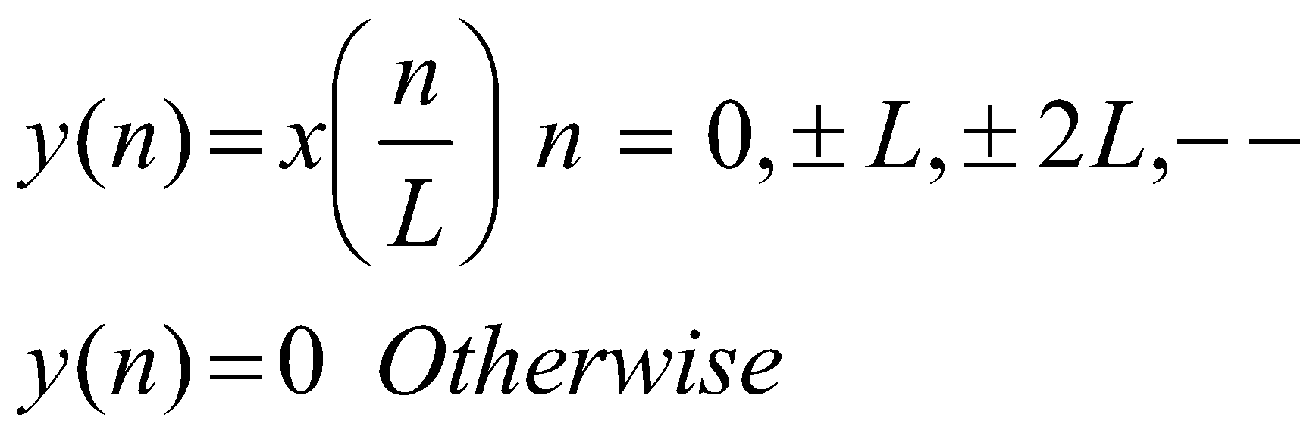
Time scaling (Interpolation)
Interpolation refers to the process of increasing the signal length by inserting zeros between signal samples.
The process consists of inserting L-1 zero valued samples between each two consecutive samples of x(n)

Slide 33
Interpolation program
Inputs to the program
x input array
L Interpolation order
Example
M = 2
x = 1. 3. 5. 2. 3.
y = 1. 0. 3. 0. 5. 0. 2. 0. 3. 0.

Slide 34
Program for interpolation
clear; clc;
M = 2;
x = [1 3 5 2 3 ];
Lx = length(x);
y = zeros(1:M*Lx);
y(1:M:M*Lx)= x;
disp(x);
disp(y);

